Slide 1
CONTINUATION OF "TYPES OF APIS"
MCP
Model Context Protocol
Why AI agents needed a new protocol beyond REST APIs — and how it actually works under the hood.
MCP Servers
MCP Clients
JSON-RPC 2.0
Tool Calling
Agentic AI

Slide 2

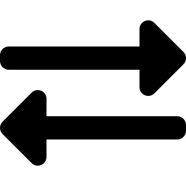
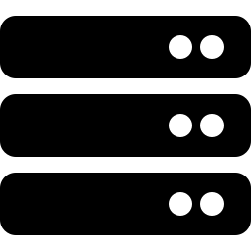



ROADMAP
What We'll Cover
Why MCP Exists
APIs vs MCP
Architecture
The problem with APIs + reasoning models
Core distinction between the two
Hosts, clients, servers & transports
Three Primitives
MCP + APIs
Adoption & Guardrails
Tools, Resources, and Prompts
Why one doesn't replace the other
Timeline, challenges, and security
2

Slide 3
01 · THE PROBLEM
Why MCP Exists
APIs were built for programs that already know exactly what they want. A model doesn't work that way — it reasons about uncertain inputs, chains tools together, and often needs to discover what's available before it knows what to do.
MCP REMOVES THE HAND-HOLDING
Manually explaining every endpoint in a long prompt
Re-writing integration glue code per tool
THE ANALOGY
A traditional API is a locked cabinet — you already need to know which drawer to open and what shape the key is.
A model is standing in front of that cabinet with no labels. MCP gives it a way to look inside and understand what's there before deciding what to use.
Guessing at parameters the model should pass
Breaking every time an endpoint or model changes
3

Slide 4
02 · CORE DISTINCTION
APIs vs MCP
 | Traditional API | MCP
Who's the client? | Another program, or a human via an app | The AI model itself, via its host application
How it's used | Developer hardcodes the exact endpoint/fields | Model discovers tools & schemas at runtime
What's exchanged | Structured requests/responses for a known contract | Machine-readable capability descriptions + calls
Integration effort | Custom code per integration | Implement once; any compliant model can use it
Contract type | Code-level contract between two applications | Semantic protocol between a model and its environment
4

Slide 5



03 · UNDER THE HOOD
Host, Client & Server
MCP architecture is a three-way split — not just client/server.
Host
Client
Server
The AI application coordinating everything — e.g. Claude Desktop, an IDE, your own agent app.
A component inside the host that maintains a 1-to-1 connection with a single server.
Exposes the actual capabilities — tools, resources, prompts — via JSON Schema.
THE WIRE FORMAT
Underneath both transports — stdio (local) and Streamable HTTP (remote) — MCP messages use JSON-RPC 2.0, the same lightweight format that powers autocomplete in most modern code editors via the Language Server Protocol.
5

Slide 6
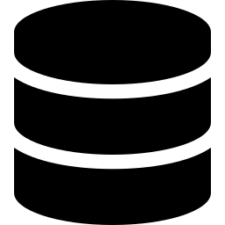

04 · BUILDING BLOCKS
MCP's Three Core Primitives
Tools
Resources
Prompts
Executable actions the model can invoke
Read-only data exposed by a URI
Reusable instruction templates
Model-controlled
Application-controlled
User-controlled
e.g. Send an email, run a SQL query
e.g. A file's contents, a DB schema
e.g. A "summarize this doc" template
Tools are things the model does. Resources are things it reads. Prompts are things a user chooses to run.
6

Slide 7
05 · WORKED EXAMPLE
Support Ticket Agent
An AI agent with access to Gmail, Notion, and Jira
THE REST API APPROACH
THE MCP APPROACH
✕
Custom integration code for each of the 3 services
✓
Gmail, Notion & Jira each expose an MCP-compatible interface
✕
Handle pagination, auth tokens, and rate limits separately
✓
The model discovers these tools automatically
✕
Teach the model via long, hardcoded prompts
✓
You provide context, not step-by-step instructions
✕
Update prompts + code whenever an endpoint changes
✓
The model reasons dynamically about which tool fits
7

Slide 8
06 · NOT A REPLACEMENT
MCP Sits on Top of APIs
This is the most commonly misunderstood part of MCP: it does not replace APIs. APIs are still the foundation — MCP changes how models access them.
AI Model
MCP Client / Server (translation layer)
Existing REST / GraphQL / gRPC / SOAP APIs
Your Backend Systems & Databases
Not "MCP vs API" — it's MCP on top of APIs. The client changes from another program to the AI model itself.
8

Slide 9
07 · ORIGIN & ADOPTION
Origin & Adoption Timeline
MCP was designed and open-sourced by Anthropic in November 2024.
Nov 2024
Mar 26, 2025
Apr 2025
Dec 2025
Anthropic designs and open-sources MCP
Streamable HTTP introduced; OpenAI adopts MCP across Agents SDK/Responses API/ChatGPT desktop; Microsoft ships Playwright-MCP — all same day
Google DeepMind confirms MCP support in Gemini
Anthropic donates MCP governance to the Agentic AI Foundation (Linux Foundation, co-founded with OpenAI and Block)
9

Slide 10



08 · REALITY CHECK
Challenges & Guardrails
Adoption
Security & Control
Developer Mindset
Servers, clients, and tooling need to converge on the same standard across the industry.
A model that can call tools directly needs clear permission boundaries — capabilities, scopes, and auth are still maturing.
Shifting from thinking in endpoints and routes to thinking in capabilities and context.
10

Slide 11
KEY TAKEAWAYS
What to Remember
1
APIs are built for deterministic program-to-program calls; MCP is built for probabilistic, reasoning-driven tool use.
2
MCP doesn't compete with REST/GraphQL/gRPC/SOAP — it standardizes how a model discovers and calls the tools behind them.
3
The real shift: calling logic moves from hardcoded app code into the model's own reasoning layer.
4
Security and permissioning are the biggest open challenges — guardrails need to live in the protocol layer.
11

Slide 12

MCP-Aware Is Becoming the Baseline
You'll soon need to know how to make your systems MCP-aware.
Thanks for reading — let's build something with it.
MCP — MODEL CONTEXT PROTOCOL · LP SERIES

